Slide 1

AI-Powered Collections: Transforming Delinquency Management at Geldium
Harnessing advanced analytics and responsible AI to revolutionize our collections process, ensuring fairness, efficiency, and superior customer experiences. This presentation outlines a strategic approach to proactive delinquency reduction.

Slide 2



EXECUTIVE OVERVIEW
A New Era of Proactive and Fair Collections
Geldium's AI-powered collections system is designed to redefine how we manage credit delinquency. By integrating sophisticated predictive models, we aim to:
Proactive Intervention
Enhanced Fairness
Operational Scalability
Identify and engage at-risk customers before issues escalate.
Ensure consistent and equitable treatment for all customers.
Automate routine tasks, freeing up human agents for complex cases.

Slide 3

SYSTEM ARCHITECTURE
How Geldium's AI Collections System Operates
Our system integrates customer data with advanced predictive analytics in a continuous feedback loop, ensuring dynamic adaptation and improvement.
01
02
1. Data Ingestion
2. Predictive Analysis
Comprehensive collection of customer financial and behavioral data: credit utilization, payment history, income, and credit scores.
A logistic regression model assigns individual delinquency risk scores, segmenting customers into various risk tiers.
03
04
3. Intelligent Actions
4. Continuous Learning Loop
Automated, personalized interventions: early reminders, flexible payment plans, or prioritized routing for human agent review.
Outcomes and customer responses are fed back into the model, refining its accuracy and effectiveness over time.

Slide 4

KEY COMPONENTS
Agentic AI: Balancing Automation with Human Expertise
Our system leverages AI for efficiency while retaining critical human oversight, ensuring a responsible and effective collections process.
Autonomous (AI-Driven)
Human-in-the-Loop
Risk Scoring & Segmentation: Instantly categorizes customers by delinquency risk.
High-Risk Decisions: Final determination for complex or sensitive accounts.
Early-Stage Reminders & Nudges: Automated, personalized communications to prevent late payments.
Dispute Handling & Exceptions: Resolving unique customer situations and irregularities.
Repayment Behavior Monitoring: Real-time tracking to adapt strategies dynamically.
Policy Review & Fairness Audits: Ensuring compliance and ethical application of AI.
Proactive Offers: Suggesting payment solutions tailored to individual customer profiles.
Complex Negotiations: Custom solutions for challenging financial circumstances.

Slide 5

ETHICAL FRAMEWORK
Responsible AI Guardrails: Ensuring Trust and Compliance
Our commitment to responsible AI is embedded in every aspect of the system, protecting both our customers and our reputation.
Fairness Monitoring
Rigorous monitoring to prevent bias across income levels, demographics, and other segments.
Explainable Risk Drivers
Transparency in AI decisions, providing clear, understandable reasons for every action and recommendation.
Human Oversight
Mandatory human review and intervention for all critical decisions, ensuring accountability and ethical judgment.
Data Privacy & Security
Adherence to the highest standards of data protection and regulatory compliance (e.g., GDPR, CCPA).

Slide 6
MEASURABLE VALUE
Expected Business Impact: Driving Efficiency and Customer Loyalty
Implementing this AI-powered system will yield significant benefits across our operations and customer relationships.
Business KPIs
Customer Outcomes
10-15% Reduction in Early-Stage Delinquency: Proactive engagement mitigates risk before it escalates.
Better Customer Experience: Proactive, empathetic outreach prevents stress and builds goodwill.
Lower Collections Costs: Automation of routine tasks reduces operational expenditure significantly.
Increased Transparency & Trust: Clear communication about actions and options fosters confidence.
Improved Operational Efficiency: Streamlined workflows and faster processing times.
Fairer & More Consistent Treatment: Standardized processes reduce human error and bias.
Enhanced Scalability: Ability to manage growing portfolios without proportional increase in resources.
Empowered Financial Management: Customers receive timely support to manage their obligations effectively.

Slide 7

CUSTOMER CENTRICITY
Reimagining the Customer Journey in Collections
Beyond numbers, our AI system focuses on transforming challenging moments into opportunities for positive customer engagement and long-term loyalty.
By offering personalized solutions and proactive communication, we aim to reduce financial stress and empower our customers.

Slide 8




STRATEGIC ADVANTAGE
Geldium's Path to Innovation Leadership
Embracing AI in collections is not just about efficiency; it's about cementing Geldium's position as a forward-thinking leader in financial services.
Pioneering Technology
Sustainable Growth
Enhanced Reputation
Leading the industry in responsible AI adoption.
Driving profitability through reduced losses and improved retention.
Building trust through transparent and fair practices.

Slide 9
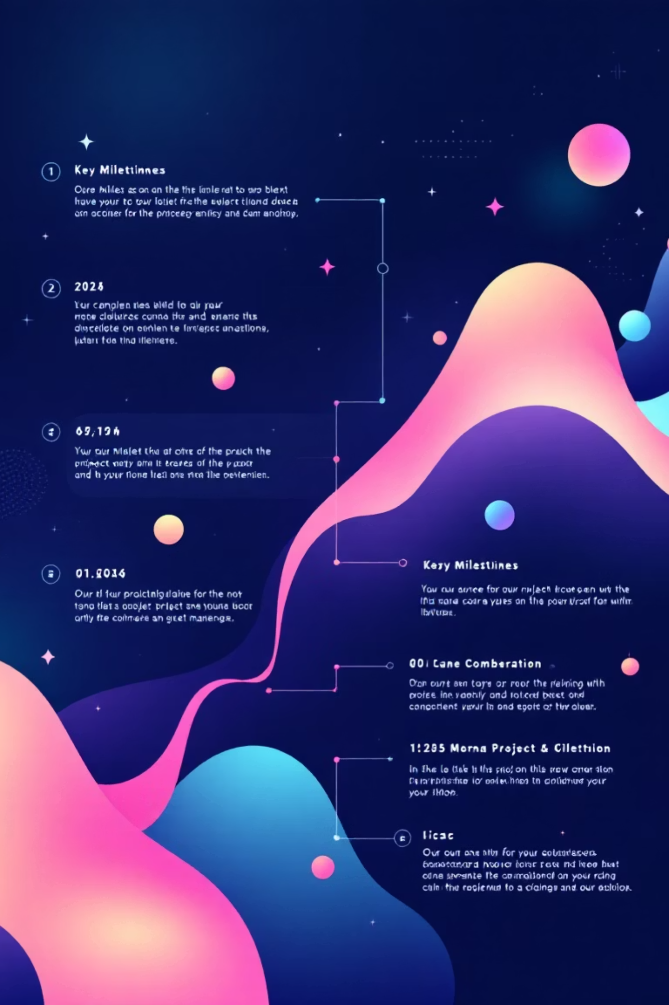
IMPLEMENTATION ROADMAP
Key Milestones for System Rollout
A phased approach ensures seamless integration and continuous optimization, minimizing disruption while maximizing impact.
1
Q1: Pilot Program Launch
Deploy limited-scope pilot; gather initial data and feedback.
2
Q2: Model Refinement
Analyze pilot results, fine-tune AI models and decision logic.
3
Q3: Phased Rollout
Expand system to additional customer segments; scale operations.
4
Q4: Full Integration & Audit
Complete system integration; conduct comprehensive fairness and performance audits.

Slide 10



The Future of Collections is Now
Geldium's AI-powered collections system represents a strategic investment in our future, promising not only financial benefits but also a more ethical and customer-centric approach to delinquency management.
Join us in shaping a smarter, fairer financial landscape.

